Slide 1
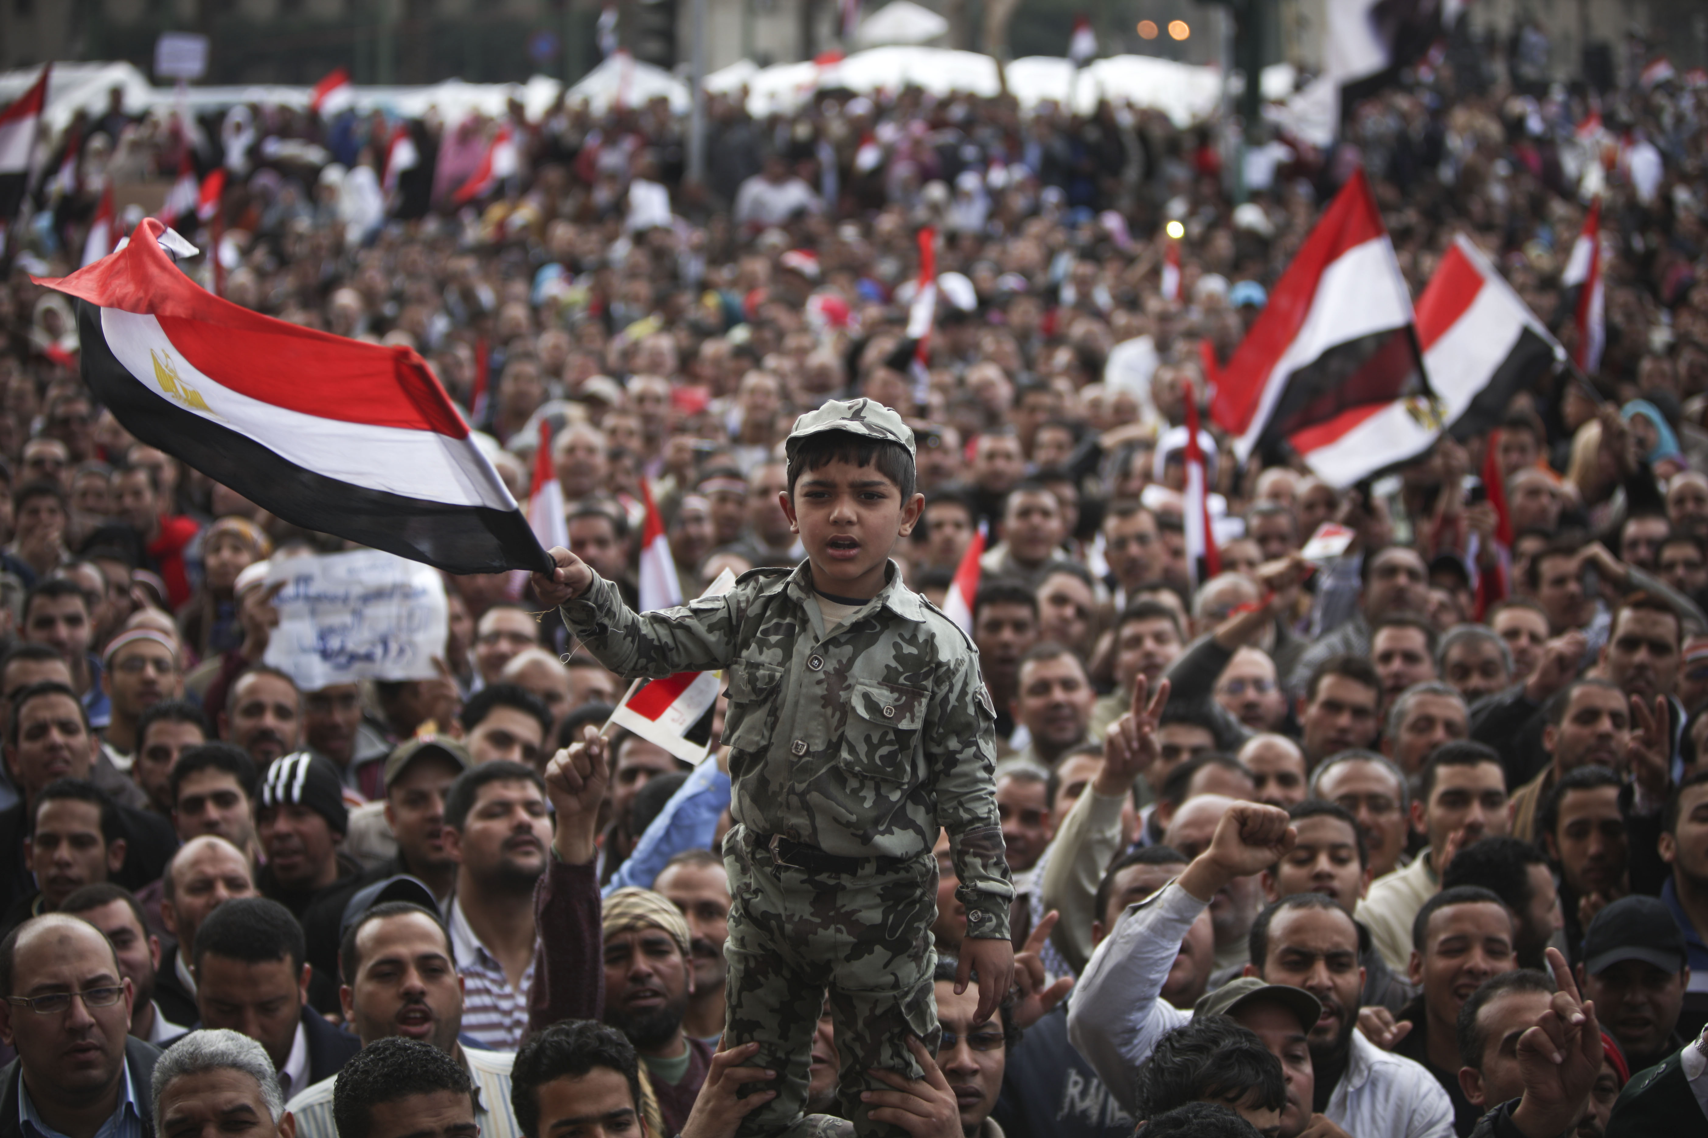
The Challenges of Egypt’s Transition
Joshua Stacher
Kent State University
September 2014

Slide 2
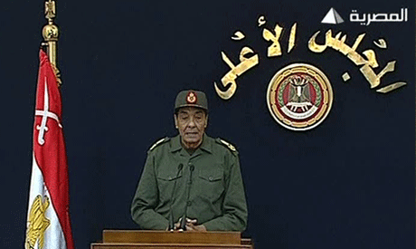
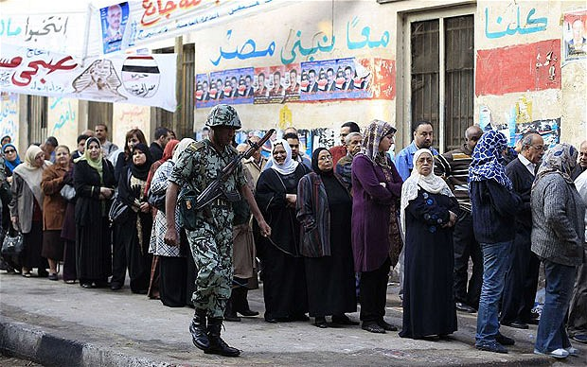
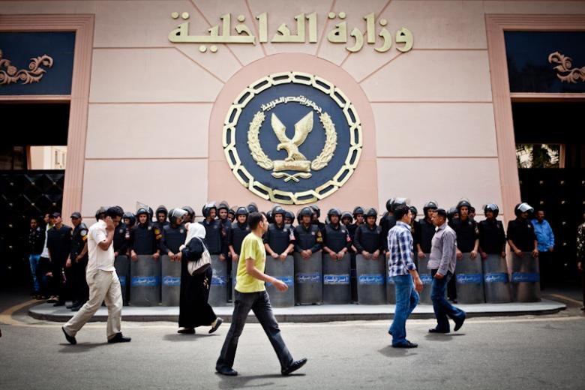
SCAF’s Transition (February 2011-July 2012)
Electionization
The Unreformed State
State Violence

Slide 3
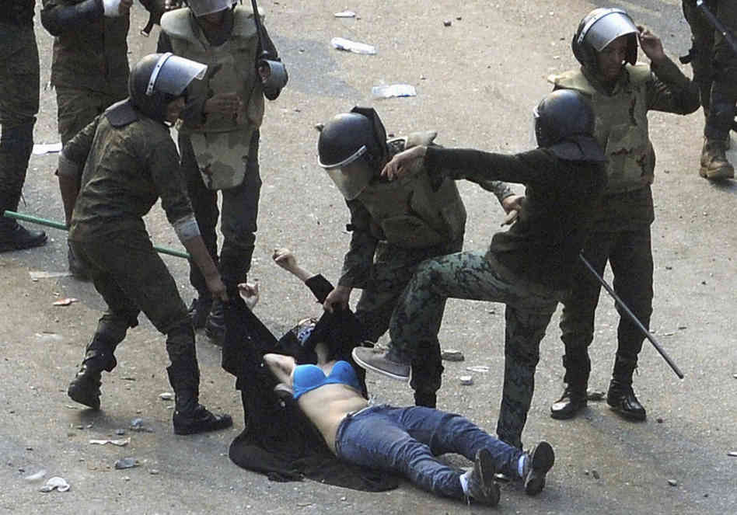
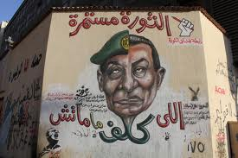
SCAF’s Transition

Slide 4
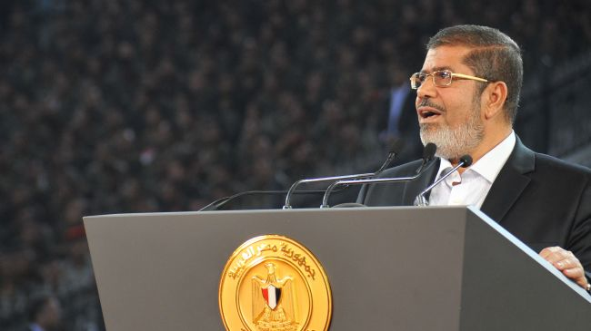
Morsi’s Presidency (July 2012-July 2013)
Break towards the State or Break towards the Street?

Slide 5
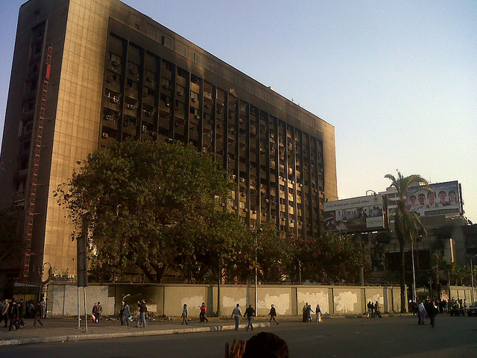
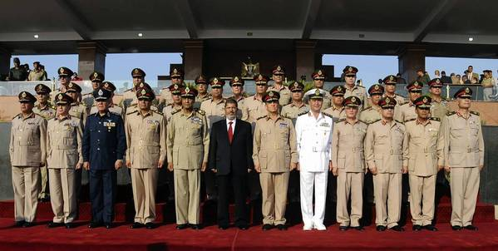
2011 & 2013
2011: Military unprepared, Revolutionaries + Muslim Brothers Overthrow Mubarak
2013: Military Prepared, Revolutionaries + Old State Overthrow Morsi
Now, Egypt’s Electorate of Thirds Cannot Cooperate
The King-like Generals
Return of the Old State?

Slide 6
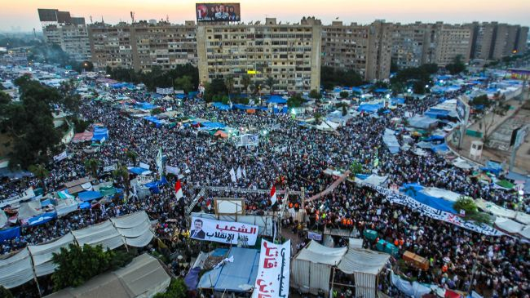
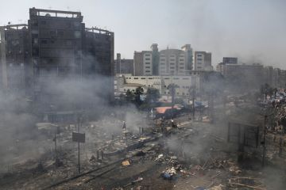
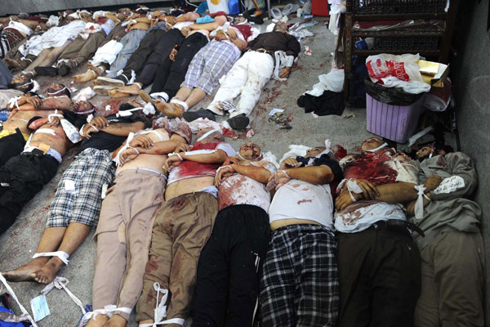
More Violence
The outlawing of the MB, State Violence, and a crackdown on dissent

Slide 7
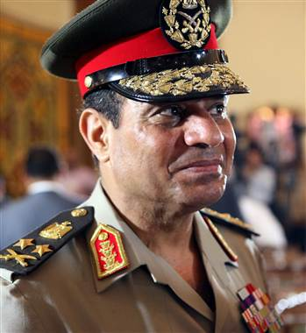
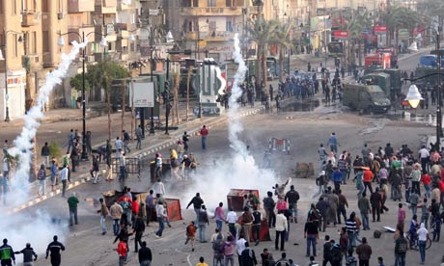
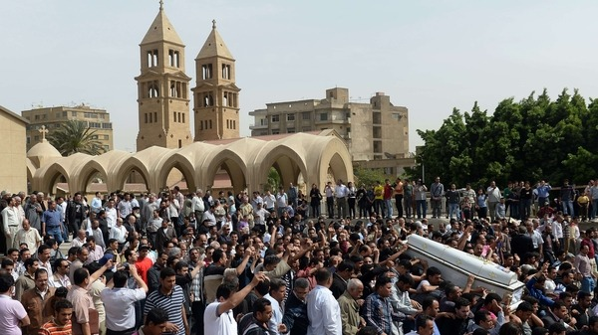
Unresolved Issues
Stability vs. Mobilization
Elections & the Precedent of a Coup
Polarization
Restive Population
No Bread, No Freedom, No Social Justice

